Slide 1

Employee Data Analysis using Excel Name : A. Suganthi Reg No : asunm110312201403 Dept : B.Com (General) College : DRBCCCHC, Pattabiram.

Slide 2

PROJECT TITLE Employees using Performance Analysis Uxcel

Slide 3
Agenda
1
2
3
4
5
Problem Statement
Project Overview
End Users
Our solutions
Data Description

Slide 4
AGENDA
6
7
8
9
10
Modelling
Result&Discussions
Conclusion
….
…..

Slide 5

PROBLEM STATEMENT
Problem Findig
Predicting future problem
Selecting
Workforce Management
Calculatons of employys current rating based on the performance
Apply conditional formatting

Slide 6

PROJECT OVERVIEW
This project involves analysing the organisation’s workforce, focusing on categorizing employees byperformance of attendenance
The analysis aimed to understand how these employees are performed during the year. Based on their performance ratings will be provided to them.

Slide 7
WHO ARE THE END USERS?
Manager: Manager allocate the work to employee
Employees: Improve workforce managementcan lead to better job satisfaction.
HR(Human Resources: Theybwill use the analysis to make informed decisions about hiring etc.
Organisations: By optimizing the mix of employee types, the organisations can improve productivity, cost management, and overll efficiency.

Slide 8
OUR SOLUTIONS AND PROPOSITION
Collect data from employee dataset .
Create a excel sheet using the dataset and analysis the performance of the employee
Branding and design alignment with other documentation
Edit and create final employee value proposition.

Slide 9
DATA DESCRIPTION
User ID: Unique employee identify
Name: Employees full name
Employee Dept: Department types
Performance: Fully meets and needs improve
Salary: Based on the performance ,salary will be allocated
Ratings: Based on the ability rating will be provided.

Slide 10
MODELLING APPROACH
Data Acquisition: Downloaded a dataset from Dashboard.
Data Preparation: Converted the data into excel format
Data Visualisation:
1. Pie Charts: Displayed to different employees types and department.

Slide 11
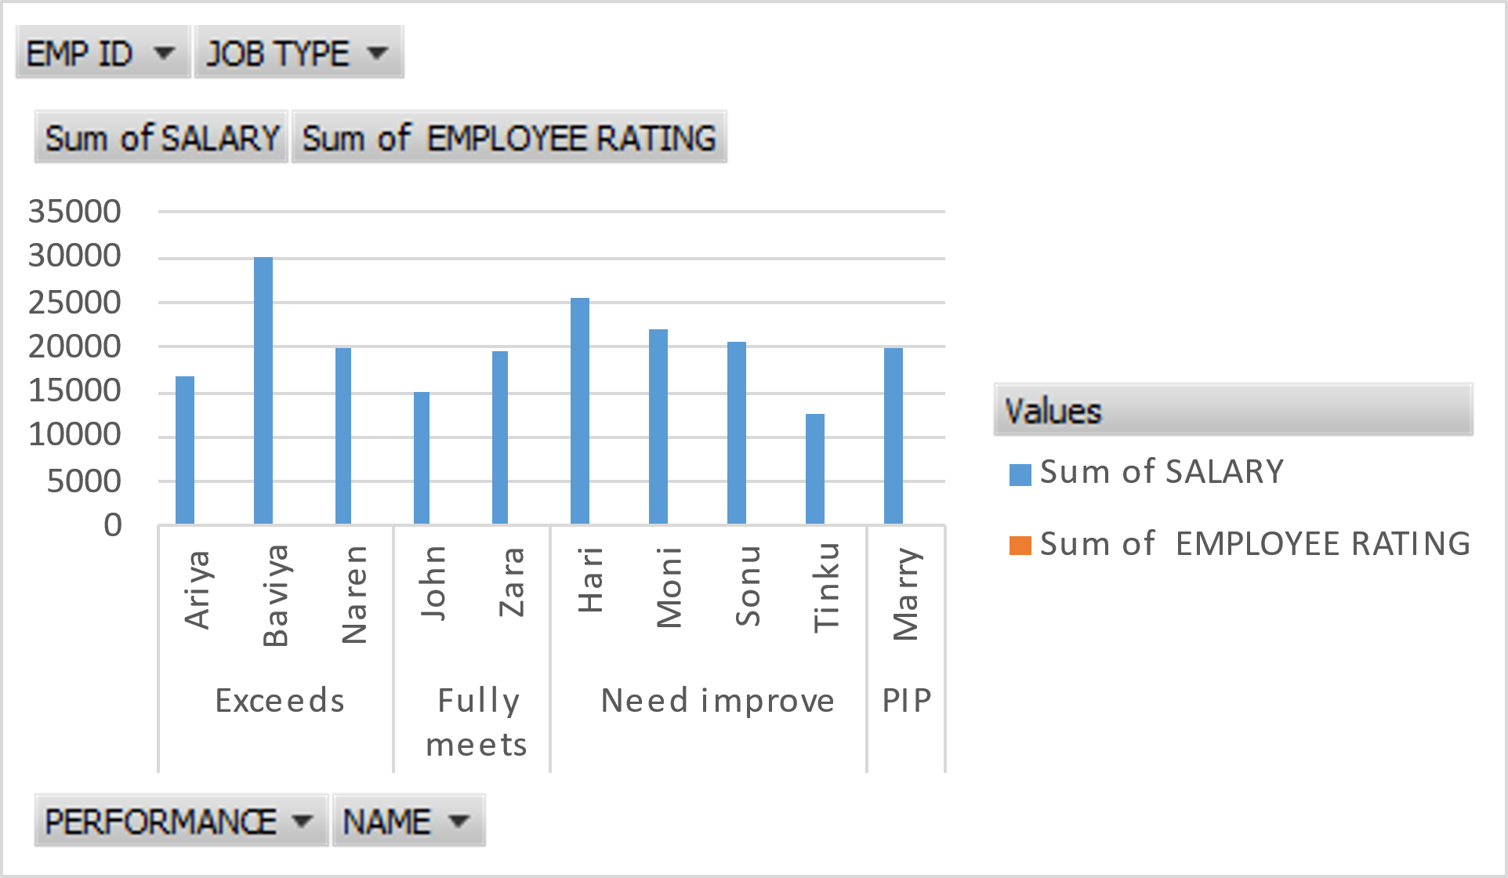
RESULTS

Slide 12
RESULTS

Slide 13
CONCLUSION:
Here I concluded the presentation about employee performance analysis using excel. Collecting the data, Analysis data, Modelling, evaluating monitoring and communication skills it helps the employee attract the customer in a easy way. Those helps to satisfy the customer needs and wants.

